Slide 1
Mobile App Development
Lecture 01

Slide 2
Introduction to dart
Dart is a client-optimized programming language for apps on multiple platforms. It is developed by Google and is used to build mobile, desktop, server, and web applications. Dart is an object-oriented, class-based, garbage-collected language with C-style syntax. Dart can compile to either native code or JavaScript.

Slide 3
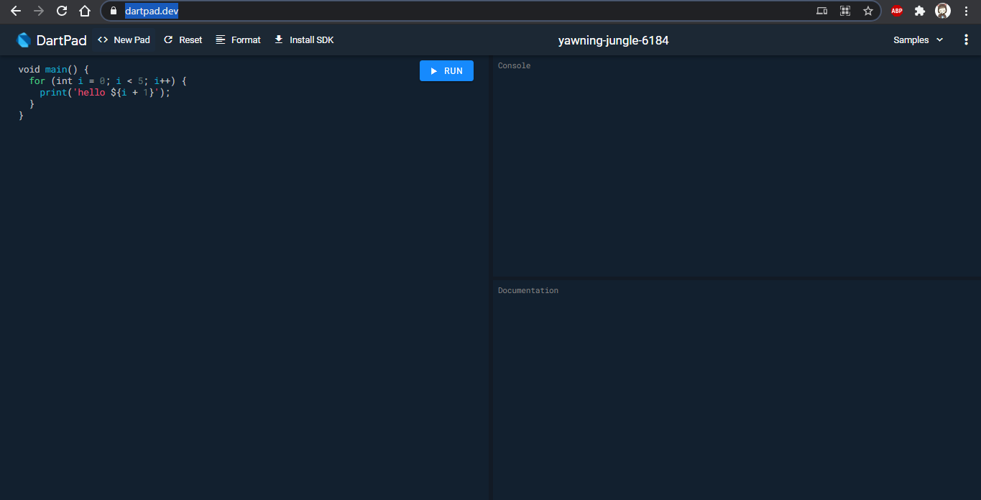
Dart Pad
https://dartpad.dev/

Slide 4
Data Types
Data Type | Keyword | Description
Number | int, double, num | Numbers in Dart are used to represent numeric literals
Strings | String | Strings represent a sequence of characters
Booleans | bool | It represents Boolean values true and false
Lists | List | It is an ordered group of objects
Maps | Map | It represents a set of values as key-value pairs

Slide 5
Numbers
The number in Dart Programming is the data type that is used to hold the numeric value. Dart numbers can be classified as:
The int data type is used to represent whole numbers.
The double data type is used to represent 64-bit floating-point numbers.
The num type is an inherited data type of the int and double types.

Slide 6
Numbers
void main() {
// declare an integer
int num1 = 2;
// declare a double value
double num2 = 1.5;
// print the values
print(num1);
print(num2);
var a1 = num.parse("1");
var b1 = num.parse("2.34");
var c1 = a1+b1;
print("Product = ${c1}");
}

Slide 7
String
It used to represent a sequence of characters. It is a sequence of UTF-16 code units. The keyword string is used to represent string literals. String values are embedded in either single or double-quotes.

Slide 8
String
void main() {
String string = ‘Digital'‘Brains';
String str = 'Coding is ';
String str1 = 'Fun';
print (string);
print (str + str1);
}

Slide 9
Boolean
It represents Boolean values true and false. The keyword bool is used to represent a Boolean literal in DART.

Slide 10
Boolean
void main() {
String str = 'Coding is ';
String str1 = 'Fun';
bool val = (str==str1);
print (val);
}

Slide 11
List
List data type is similar to arrays in other programming languages. A list is used to represent a collection of objects. It is an ordered group of objects.

Slide 12
List
void main()
{
List gfg = new List(3);
gfg[0] = 'Geeks';
gfg[1] = 'For';
gfg[2] = 'Geeks';
print(gfg);
print(gfg[0]);
}

Slide 13
Map
The Map object is a key and value pair. Keys and values on a map may be of any type. It is a dynamic collection.

Slide 14
Map
void main() {
Map gfg = new Map();
gfg['First'] = 'Geeks';
gfg['Second'] = 'For';
gfg['Third'] = 'Geeks';
print(gfg);
}

